Slide 1

PL/SQL DAY3

Slide 2
PL/SQL Block Types
Anonymous
DECLARE
BEGIN
-statements
EXCEPTION
END;
Procedure
PROCEDURE <name>
IS
BEGIN
-statements
EXCEPTION
END;
Function
FUNCTION <name>
RETURN <datatype>
IS
BEGIN
-statements
EXCEPTION
END;

Slide 3
PL/SQL Variable Types
Scalar (char, varchar2, number, date, etc)
Composite (%rowtype)
Reference (pointers)
LOB (large objects)
Note: Non PL/SQL variables include bind variables,
host (“global”) variables, and parameters.

Slide 4
Variable Naming Conventions
Two variables can have the same name if they are in different blocks (bad idea)
The variable name should not be the same as any table column names used in the block.

Slide 5
PL/SQL is strongly typed
All variables must be declared before their use.
The assignment statement
: =
is not the same as the equality operator
=
All statements end with a ;

Slide 6
Manipulating Character Strings with PL/SQL
To concatenate two strings in PL/SQL, you use the double bar (||) operator:
new_string := string1 || string2;
To remove blank leading spaces use the LTRIM function:
string := LTRIM(string_variable_name);
To remove blank trailing spaces use the RTRIM function:
string := RTRIM(string_variable_name);
To find the number of characters in a character string use the LENGTH function:
string_length := LENGTH(string_variable_name);

Slide 7
Manipulating Character Strings with PL/SQL
To change case, use UPPER, LOWER, INITCAP
INSTR function searches a string for a specific substring:
start_position := INSTR(original_string, substring);
SUBSTR function extracts a specific number of characters from a character string, starting at a given point:
extracted_string := SUBSTR(string_variable, starting_point, number_of_characters);

Slide 8
COMMON PL/SQL STRING FUNCTIONS
CHR(asciivalue)
ASCII(string)
LOWER(string)
SUBSTR(string,start,substrlength)
LTRIM(string)
RTRIM(string)
LPAD(string_to_be_padded, spaces_to_pad, |string_to_pad_with|)
RPAD(string_to_be_padded, spaces_to_pad, |string_to_pad_with|)
REPLACE(string, searchstring, replacestring)
UPPER(string)
INITCAP(string)
LENGTH(string)

Slide 9
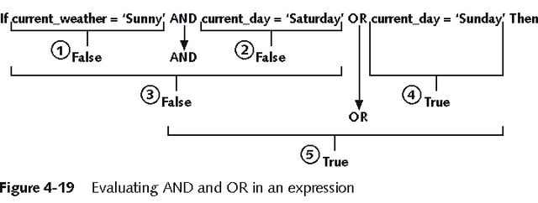
Complex Conditions
Created with logical operators AND, OR and NOT
AND is evaluated before OR
Use () to set precedence

Slide 10
Reference data types
In many cases, a PL/SQL variable will be used to manipulate data stored in a existing table. In this case, it is essential that the variable have the same type (compatible is also ok in some situation) as the relation column.
Directly reference a specific database field or record and assume the data type of the associated field or record
%TYPE: same data type as a database field
%ROWTYPE: same data type as a database record

Slide 11
%TYPE vs %ROWTYPE - What's the difference?
Description: Both %TYPE and %ROWTYPE are used to define variables in PL/SQL as it is defined within the database.
If the data type or precision of a column changes, the program automatically picks up the new definition from the database. The %TYPE and %ROWTYPE constructs provide data independence, reduce maintenance costs, and allows programs to adapt as the database changes.

Slide 12
What are the advantages of using these over data types?
% TYPE provides the data type of a variable or a database column to that variable.
% ROWTYPE provides the record type that represents a entire row of a table or view or columns selected in the cursor.
The advantages are :
Need not know about variable's data type
If the database definition of a column in a table changes, the data type of a variable changes accordingly.

Slide 13
What are % TYPE and % ROWTYPE ?
%TYPE can be used with the column name preceded with table name to decide the data type and length of the variable at runtime. In this case there is no dependency on changes made to the data structure. %ROWTYPE can be used to declare the variable having the same no. of variables inside it (ROWTYPE) as no. of columns there in the table. In this case columns selected with SELECT statement must match with variables inside the rowtype variable. If not then individually refer these variables inside the ROWTYPE variables

Slide 14
-- %TYPE is used to declare a field with the same type as
-- that of a specified table's column:
DECLARE v_EmpName
emp.ename%TYPE;
BEGIN
SELECT ename INTO v_EmpName FROM emp WHERE ROWNUM = 1;
DBMS_OUTPUT.PUT_LINE('Name = ' || v_EmpName);
END;
/
-- %ROWTYPE is used to declare a record with the same types as Found in the specified database table, view or cursor:
DECLARE v_emp emp%ROWTYPE;
BEGIN v_emp.empno := 10;
v_emp.ename := 'XXXXXXX';
END;
/

Slide 15
Using SQL in procedures
Select values into PL/SQL variables
using INTO
Record.element notation will address components of tuples (dot notation)
%rowtype allows full rows to be selected into one variable
Empid empname addr1 addr2 addr3 postcode grade salary
V_employee employee%rowtype
Notes:
The SQL statements are seamlessly integrated into the PL/SQL scripts. There are no special characters required to prefix the commands with as the database will automatically internally handle these commands. The only concession required is the INTO clause. All values which are returned by a select statement must be stored in a variable. The statement INTO indicates where to store the data. By referencing the record and specifying the element of that record you can update or delete specific data in the system (example on the next slide).
%rowtype is a datatype that has not been stated earlier, what this means is that an entire row is held as a variable. By declaring a variable as a rowtype of a specific table you are able to retrieve whole rows of data and store that data in one record. This will then be used to support record.element notation

Slide 16
Example (Anonymous Block of Code)
Declare
v_employee employee%rowtype;
Begin
select *
into v_employee
from employee
where empid = 65284;
update employee
set salary = v_employee.salary + 1000
where empid = v_employee.empid;
End;
Selects entire row of data into 1 variable called v_employee
Is updating the value of salary based on selected element of a variable
Notes:
The use of %rowtype is similar to an array, each row is held in one variable and then data from specific elements of the record are accessed by their field name in the same way an array accesses data based on the position of that data in the array.

Slide 17
%ROWTYPE
Set serveroutput on
DECLARE
v_student students%rowtype;
BEGIN
select * into v_student
from students
where sid='123456';
DBMS_OUTPUT.PUT_LINE (v_student.lname);
DBMS_OUTPUT.PUT_LINE (v_student.major);
DBMS_OUTPUT.PUT_LINE (v_student.gpa);
END;
/

Slide 18
SELECT INTO
SET SERVEROUTPUT ON
DECLARE
v_max_gpa number(3,2);
v_numstudents number(4);
v_lname students.lname%type;
v_major students.major%type;
BEGIN
select max(gpa) into v_max_gpa
from students;
DBMS_OUTPUT.PUT_LINE ('The highest GPA is '||v_max_gpa);
select count(sid) into v_numstudents
from students
where gpa = v_max_gpa;
IF v_numstudents > 1 then
DBMS_OUTPUT.PUT_LINE ('There are '||v_numstudents||' with that GPA');
ELSE
select lname, major into v_lname, v_major
from students
where gpa=v_max_gpa;
DBMS_OUTPUT.PUT_LINE ('The student name is '||v_lname);
DBMS_OUTPUT.PUT_LINE ('The student major is '||v_major);
END IF;
END;
/

Slide 19
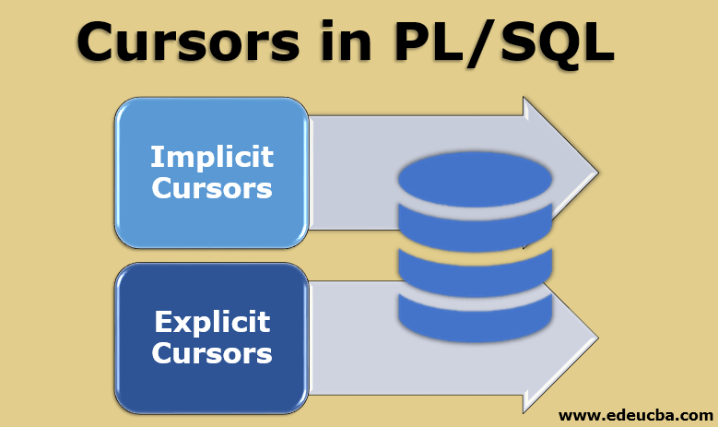
CURSORS

Slide 20
CURSOR
PL/SQL creates an implicit cursor (a private work area for that statement) when an SQL statement is executed from within the program block.
This work area stores the statement and the results returned by execution of that statement.
If a cursor is not declared, it is created automatically and is known as an implicit cursor. An implicit cursor is used when the embedded SQL statement returns no more than one row.
If used in such examples, a TOO_MANY_ROWS exception. On the other hand, if the SQL statement returns more than one row, an explicit cursor is needed.

Slide 21
Cursors in SQL
Enables users to loop around a selection of data.
Stores data selected from a query in a temp area for use when opened.
Use complex actions which would not be feasible in standard SQL selection queries
Pointer to a memory location that the DBMS uses to process a SQL query
Use to retrieve and manipulate database data

Slide 22
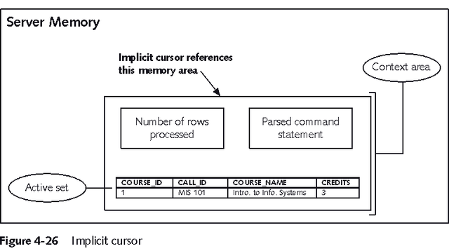
Implicit Cursor

Slide 23
Using an Implicit Cursor
Executing a SELECT query creates an implicit cursor
To retrieve it into a variable use INTO:
SELECT field1, field2, ...
INTO variable1, variable2, ...
FROM table1, table2, ...
WHERE join_ conditions
AND search_condition_to_retrieve_1_record;
Can only be used with queries that return exactly one record

Slide 24
Explicit Cursor
Use for queries that return multiple records or no records
Must be explicitly declared and used
Four actions can be performed on an explicit cursor:
1. Declare a cursor with a name 2. Open the cursor 3. Fetch row(s) from the cursor 4. Close the cursor

Slide 25
Implicit cursors
Whenever Oracle executes an SQL statement such as SELECT INTO, INSERT, UPDATE, and DELETE, it automatically creates an implicit cursor.
Oracle internally manages the whole execution cycle of implicit cursors and reveals only the cursor’s information and statuses such as SQL%ROWCOUNT, SQL%ISOPEN, SQL%FOUND, and SQL%NOTFOUND.
The implicit cursor is not elegant when the query returns zero or multiple rows which cause NO_DATA_FOUND or TOO_MANY_ROWS exception respectively.

Slide 26
Using an Explicit Cursor
Declare the cursor
CURSOR cursor_name IS select_query;
Open the cursor
OPEN cursor_name;
Fetch the data rows
LOOP
FETCH cursor_name INTO variable_name(s);
EXIT WHEN cursor_name%NOTFOUND;
Close the cursor
CLOSE cursor_name;

Slide 27
Explicit cursors
An explicit cursor is an SELECT statement declared explicitly in the declaration section of the current block or a package specification.
For an explicit cursor, you have control over its execution cycle from OPEN, FETCH, and CLOSE.
Oracle defines an execution cycle that executes an SQL statement and associates a cursor with it.

Slide 28
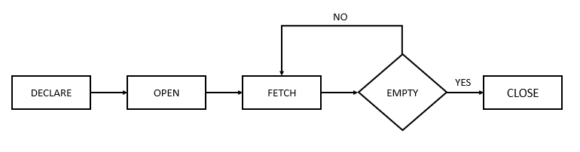
EXPLICIT CURSOR

Slide 29
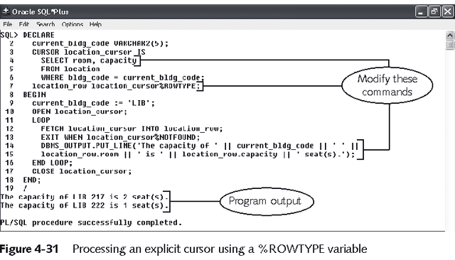
Explicit Cursor with %ROWTYPE

Slide 30
Syntax for Cursors
Declared as a variable in the same way as standard variables
Identified as cursor type
SQL included
E.g.
Cursor cur_emp is
Select emp_id, surname name, grade, salary
From employee
Where regrade is true;

Slide 31
Cursors
A cursor is a temp store of data.
The data is populated when the cursor is opened.
Once opened the data must be moved from the temp area to a local variable to be used by the program. These variables must be populated in the same order that the data is held in the cursor.
The data is looped round till an exit clause is reached.

Slide 32
Cursor Functions
Active set
7369 SMITH CLERK
7566 JONES MANAGER
7788 SCOTT ANALYST
7876 ADAMS CLERK
7902 FORD ANALYST
Cursor
Current row

Slide 33
Controlling Cursor
No
DECLARE
OPEN
FETCH
Yes
CLOSE
EMPTY?
Create a named SQL area
Identify the active set
Load the current row into variables
Test for existing rows
Release the active set
Return to FETCH if rows found

Slide 34
Controlling Cursor…
Open the cursor.
Pointer
Cursor
Fetch a row from the cursor.
Pointer
Cursor
Continue until empty.
Pointer
Cursor
Close the cursor.
Cursor

Slide 35
Cursor Attributes
Obtain status information about a cursor.
Attribute Type Description
%ISOPEN Boolean Evaluates to TRUE if the cursor is open
%NOTFOUND Boolean Evaluates to TRUE if the most recent fetch does not return a row
%FOUND Boolean Evaluates to TRUE if the most recent fetch returns a row; complement of %NOTFOUND
%ROWCOUNT Number Evaluates to the total number of rows returned so far

Slide 36
The %ISOPEN Attribute
Fetch rows only when the cursor is open.
Use the %ISOPEN cursor attribute before performing a fetch to test whether the cursor is open.
Example
IF NOT cur_sample%ISOPEN THEN
OPEN cur_sample;
END IF;
LOOP
FETCH cur_sample...

Slide 37
Cursors and Records
Process the rows of the active set conveniently by fetching values into a PL/SQL RECORD.
Example
DECLARE
CURSOR emp_cursor IS
SELECT empno, ename
FROM emp;
emp_record emp_cursor%ROWTYPE;
BEGIN
OPEN emp_cursor;
LOOP
FETCH emp_cursor INTO emp_record;
...

Slide 38
Cursor FOR Loops
Syntax
The cursor FOR loop is a shortcut to process cursors.
Implicitly opens, fetches, and closes cursor.
The record is implicitly declared.
FOR record_name IN cursor_name LOOP
statement1;
statement2;
. . .
END LOOP;

Slide 39
Cursor FOR Loops: An Example
Retrieve employees one by one until no more are left.
Example
DECLARE
CURSOR emp_cursor IS
SELECT ename, deptno
FROM emp;
BEGIN
FOR emp_record IN emp_cursor LOOP
-- implicit open and implicit fetch occur
IF emp_record.deptno = 30 THEN
...
END LOOP; -- implicit close occurs
END;

Slide 40
SET SERVEROUTPUT ON
SET VERIFY OFF
DECLARE hdate DATE;
CURSOR Temp_Cursor is SELECT hdate from employee;
BEGIN
OPEN Temp_Cursor; LOOP FETCH Temp_Cursor INTO hdate; EXIT WHEN Temp_Cursor%NOTFOUND;
IF hdate > '01-JAN-15' THEN DBMS_OUTPUT.PUT_LINE ('The employee is JUNIOR'); ELSE DBMS_OUTPUT.PUT_LINE ('The employee is SENIOR'); END IF; END LOOP; COMMIT; IF Temp_Cursor%ISOPEN THEN CLOSE Temp_Cursor; END IF; EXCEPTION WHEN OTHERS THEN DBMS_OUTPUT.PUT_LINE ('Error in Seniority Dtermination'); IF Temp_Cursor%ISOPEN THEN CLOSE Temp_Cursor; END IF; ROLLBACK;

Slide 41
If the salary of the employe is <20000, update the salary by 5000
DECLARE
c_id customers.id%type := 1;
c_sal customers.salary%type;
BEGIN
SELECT salary
INTO c_sal
FROM customers
WHERE id = c_id;
IF (c_sal <= 2000) THEN
UPDATE customers
SET salary = salary + 5000
WHERE id = c_id;
dbms_output.put_line ('Salary updated');
END IF;
END;
/

Slide 42
STRINGS
DECLARE
greetings varchar2(11) := 'hello world';
BEGIN
dbms_output.put_line(UPPER(greetings));
dbms_output.put_line(LOWER(greetings));
dbms_output.put_line(INITCAP(greetings));
/* retrieve the first character in the string */
dbms_output.put_line ( SUBSTR (greetings, 1, 1));
/* retrieve the last character in the string */
dbms_output.put_line ( SUBSTR (greetings, -1, 1));
/* retrieve five characters, starting from the seventh position. */
dbms_output.put_line ( SUBSTR (greetings, 7, 5));
/* retrieve the remainder of the string, starting from the second position. */
dbms_output.put_line ( SUBSTR (greetings, 2));
/* find the location of the first "e" */
dbms_output.put_line ( INSTR (greetings, 'e'));
END;
/

Slide 43
STRINGS
DECLARE
greetings varchar2(30) := '......Hello World.....';
BEGIN
dbms_output.put_line(RTRIM(greetings,'.'));
dbms_output.put_line(LTRIM(greetings, '.'));
dbms_output.put_line(TRIM( '.' from greetings));
END;
/

Slide 44
CURSORS
EXAMPLES

Slide 45
Explicit cursors
DECLARE
v_name donor.name%TYPE;
v_yrgoal donor.yrgoal%TYPE;
v_state donor.state%TYPE;
CURSOR donor_cursor IS
SELECT name, yrgoal, state
FROM donor;
BEGIN
OPEN donor_cursor;
FETCH donor_cursor INTO v_name, v_yrgoal, v_state;
WHILE donor_cursor%FOUND LOOP
INSERT INTO donor_part
VALUES(v_name, v_yrgoal, v_state);
FETCH donor_cursor INTO v_name, v_yrgoal, v_state;
END LOOP;
CLOSE donor_cursor;
END;
/
SQL> edit cursor1
SQL> @ cursor1
PL/SQL procedure successfully completed.
SQL> SELECT * FROM donor_part;
NAME YRGOAL ST
--------------- --------- --
Stephen Daniels 500 MA
Jennifer Ames 400 RI
Carl Hersey RI
Susan Ash 100 MA
Nancy Taylor 50 MA
Robert Brooks 50 MA
The table donor_part was empty before cursor1 was executed. After running the anonymous block, there are now six records in the table. They correspond to the six records that were in the donor table.
Notes:
The cursor structure allows you to process multiple records, one record at a time within PL/SQL.
On the next slide will look at the data and on the following slide we will look at the components of the block.

Slide 46
Explicit cursor
SQL> SELECT * FROM donor;
IDNO NAME STADR CITY ST ZIP DATEFST YRGOAL CONTACT
----- --------------- --------------- ---------- -- ----- --------- --------- ------------
11111 Stephen Daniels 123 Elm St Seekonk MA 02345 03-JUL-98 500 John Smith
12121 Jennifer Ames 24 Benefit St Providence RI 02045 24-MAY-97 400 Susan Jones
22222 Carl Hersey 24 Benefit St Providence RI 02045 03-JAN-98 Susan Jones
23456 Susan Ash 21 Main St Fall River MA 02720 04-MAR-92 100 Amy Costa
33333 Nancy Taylor 26 Oak St Fall River MA 02720 04-MAR-92 50 John Adams
34567 Robert Brooks 36 Pine St Fall River MA 02720 04-APR-98 50 Amy Costa
6 rows selected.
SQL> SELECT * FROM donor_part;
NAME YRGOAL ST
--------------- --------- --
Stephen Daniels 500 MA
Jennifer Ames 400 RI
Carl Hersey RI
Susan Ash 100 MA
Nancy Taylor 50 MA
Robert Brooks 50 MA
Initial FETCH got the first record from the table and put the data into the variables. The INSERT inside the loop put the data from the variables into the new table.
The FETCH after the INSERT (the last command in the loop) got the second record from the table and put the data in the variables. The INSERT inside the loop put the data from the variables into the new table.
The FETCH after the INSERT (the last command in the loop) got the third record from the table and put the data in the variables. The INSERT inside the loop put the data from the variables into the new table.
Notes:
As you can see, information from the donor table is now in the donor_part table.
When the FETCH after the INSERT (the last command in the loop) does not retrieve data the LOOP will end.

Slide 47
Explicit cursor
These are the variable names declared to receive the data from the table.
DECLARE
v_name donor.name%TYPE;
v_yrgoal donor.yrgoal%TYPE;
v_state donor.state%TYPE;
CURSOR donor_cursor IS
SELECT name, yrgoal, state
FROM donor;
BEGIN
OPEN donor_cursor;
FETCH donor_cursor INTO v_name, v_yrgoal, v_state;
WHILE donor_cursor%FOUND LOOP
INSERT INTO donor_part
VALUES(v_name, v_yrgoal, v_state);
FETCH donor_cursor INTO v_name, v_yrgoal, v_state;
END LOOP;
CLOSE donor_cursor;
END;
/
The cursor is created with a select statement. The select statement will be processed by the cursor providing the rows to be processed in the block.
The OPEN statement opens or activates the cursor - this means the select is executed to fill the cursor with rows.
The FETCH statement gets the first record in the cursor and moves the data to the defined variables. This is the initial FETCH.
The FETCH which is the last statement in the loop will get all other records.
When the loop is complete the cursor is closed.
The WHILE loop will continue to execute while there is still data in the cursor. This is tested with the %FOUND. Note that when the loop is entered, the FETCH of the initial record has already been done. The INSERT statement will insert the data from that record into the table named donor_part. Then it will execute the FETCH which is the last statement in the loop to get the next record. As long as a record is found, the INSERT will be done followed by another FETCH. When the FETCH is unsuccessful, the WHILE will terminate because of donor_cursor%FOUND.
INSERT puts a record into donor_part containing the information that the FETCH put into the variables.
Notes:
Note that the variable names use TYPE so that they have the columns on the donor table that is being used as input to the block code.
Notice that there is an initial FETCH that fetches the first record. Then the processing loop is entered and the record gets processed. There is another FETCH at the bottom of the processing loop which will get another record.

Slide 48
Explicit cursor
DECLARE
v_name donor.name%TYPE;
v_yrgoal donor.yrgoal%TYPE;
v_state donor.state%TYPE;
CURSOR donor_cursor IS
SELECT name, yrgoal, state
FROM donor;
BEGIN
OPEN donor_cursor;
FETCH donor_cursor INTO v_name, v_yrgoal, v_state;
WHILE donor_cursor%FOUND LOOP
IF v_yrgoal > 50 THEN
INSERT INTO donor_part
VALUES(v_name, v_yrgoal, v_state);
END IF;
FETCH donor_cursor INTO v_name, v_yrgoal, v_state;
END LOOP;
CLOSE donor_cursor;
END;
/
SQL> edit cursor2
SQL> @ cursor2
PL/SQL procedure successfully completed.
SQL> SELECT * FROM donor_part;
NAME YRGOAL ST
--------------- --------- --
Stephen Daniels 500 MA
Jennifer Ames 400 RI
Susan Ash 100 MA
The IF statement only INSERTs records where the year goal is greater than 50. Only the three records shown met the criteria.
Notes:
Two of the records on donor have a year goal of 50 and one has a null year goal. These three records were not inserted because of the IF statement.

Slide 49
Explicit cursor
DECLARE
v_name donor.name%TYPE;
v_yrgoal donor.yrgoal%TYPE;
v_state donor.state%TYPE;
CURSOR donor_cursor IS
SELECT name, yrgoal, state
FROM donor
WHERE yrgoal> 50;
BEGIN
OPEN donor_cursor;
FETCH donor_cursor INTO v_name, v_yrgoal, v_state;
WHILE donor_cursor%FOUND LOOP
INSERT INTO donor_part
VALUES(v_name, v_yrgoal, v_state);
FETCH donor_cursor INTO v_name, v_yrgoal, v_state;
END LOOP;
CLOSE donor_cursor;
END;
/
SQL> edit cursor2a
SQL> @ cursor2a
PL/SQL procedure successfully completed.
SQL> SELECT * FROM donor_part;
NAME YRGOAL ST
--------------- --------- --
Stephen Daniels 500 MA
Jennifer Ames 400 RI
Susan Ash 100 MA
Instead of selecting the record after they have been FETCHed with the IF, you can SELECT the records that meet the condition in the CURSOR with the WHERE clause.
Notes:
Because of the WHERE clause only records with a yearly goal greater than 50 are in the cursor. Therefore only those records get processed to the new table.

Slide 50
Explicit cursor
DECLARE
v_name donor.name%TYPE;
v_yrgoal donor.yrgoal%TYPE;
v_state donor.state%TYPE;
CURSOR donor_cursor IS
SELECT name, yrgoal, state
FROM donor
WHERE yrgoal> 50;
BEGIN
OPEN donor_cursor;
FETCH donor_cursor INTO v_name, v_yrgoal, v_state;
LOOP
INSERT INTO donor_part
VALUES(v_name, v_yrgoal, v_state);
FETCH donor_cursor INTO v_name, v_yrgoal, v_state;
EXIT WHEN donor_cursor%NOTFOUND;
END LOOP;
CLOSE donor_cursor;
END;
/
SQL> edit cursor2b
SQL> @ cursor2b
PL/SQL procedure successfully completed.
SQL> SELECT * FROM donor_part;
NAME YRGOAL ST
--------------- --------- --
Stephen Daniels 500 MA
Jennifer Ames 400 RI
Susan Ash 100 MA
This code changes to a simple LOOP with an exit based on %NOTFOUND instead of %FOUND.
Notes:
Please be sure to check the notes for cursor attributes. They are discussed in the notes but not in this presentation

Slide 51
Explicit cursor
DECLARE
v_name donor.name%TYPE;
v_yrgoal donor.yrgoal%TYPE;
v_state donor.state%TYPE;
CURSOR donor_cursor IS
SELECT name, yrgoal, state
FROM donor;
BEGIN
OPEN donor_cursor;
FETCH donor_cursor INTO v_name, v_yrgoal, v_state;
WHILE donor_cursor%ROWCOUNT < 5 AND donor_cursor%FOUND LOOP
INSERT INTO donor_part
VALUES(v_name, v_yrgoal, v_state);
FETCH donor_cursor INTO v_name, v_yrgoal, v_state;
END LOOP;
CLOSE donor_cursor;
END;
/
SQL> @ cursor3
PL/SQL procedure successfully completed.
SQL> SELECT * FROM donor_part;
NAME YRGOAL ST
--------------- --------- --
Stephen Daniels 500 MA
Jennifer Ames 400 RI
Carl Hersey RI
Susan Ash 100 MA
The while loop will terminate after 4 records have been processed or when no more records are in the cursor. %ROWCOUNT is used to determine when 4 records have been processed.
Notes:
As stated, I want to only process 4 records but in case there are not 4 records, good programming means I also test for essentially end of file - in this case, no more records in the cursor. So if row count is > 4 OR there are no more records, processing will terminate.
When I put these conditions in a WHILE loop, I have to phrase them as the conditions to keep processing. Therefore, I say keep processing while rowcount is < 5 AND there are still records.

Slide 52
Logic
Rowcount > 4
N
Y
OR LOGIC: Logic for if row count is > 4 OR there are no more records stop processing. Otherwise process the records.
Stop
processing
No records
N
Y
Process
Stop
processing
AND LOGIC: Logic for if row count is < 5 and there are records to process, process. If either condition is false, do not process.
Rowcount < 5
N
Y
Records to
process
Stop
processing
N
Y
Stop
processing
Process
WHILE donor_cursor%ROWCOUNT < 5 AND donor_cursor%FOUND LOOP
Notes:
This shows the logic discussed on the previous slide. Notice that the same objectives are accomplished but one expresses the logic with the OR logic that decides when to stop and the other expresses the logic with the AND logic that decides when to process.

Slide 53
A variation using WHILE Loop and %FOUND
DECLARE
CURSOR low_pay IS SELECT surname,salary FROM Personnel where salary < 30000;
v_surname personnel.surname%TYPE;
v_salary personnel.salary%TYPE;
BEGIN
OPEN low_pay;
FETCH low_pay INTO v_surname, v_salary;
WHILE low_pay%FOUND LOOP
DBMS_OUTPUT.PUT_LINE(v_surname ||' '|| v_salary);
FETCH low_pay INTO v_surname, v_salary;
END LOOP;
CLOSE low_pay;
END;
Note 2 FETCH commands

Slide 54
Parameters in Cursors
Block2
DECLARE
CURSOR c_salary (p_min number,p_max number)
IS SELECT surname,salary FROM Personnel
where salary between p_min and p_max;
v_surname Personnel.surname%TYPE;
v_salary Personnel.salary%TYPE;
BEGIN
OPEN c_salary(&p_min, &p_max);
LOOP
FETCH c_salary INTO v_surname, v_salary;
EXIT WHEN c_salary%NOTFOUND;
DBMS_OUTPUT.PUT_LINE(v_surname||' '||v_salary);
END LOOP;
CLOSE c_salary;
END;
These would be in quotes for VARCHAR2 variables

Slide 55
FOR LOOP requires no CURSOR OPEN, FETCH, CLOSE
DECLARE
CURSOR c_salary IS SELECT surname,salary
FROM Personnel
where salary < 30000;
BEGIN
FOR counter in c_salary LOOP
DBMS_OUTPUT.PUT_LINE(counter.surname
||' '||counter.salary);
END LOOP
END;

Slide 56
SELECT FOR UPDATE Cursors
Useful when updating or deleting each row fetched in a cursor otherwise all would be updated at once
DECLARE
CURSOR c_salary IS SELECT surname,salary FROM Personnel
FOR UPDATE;
v_surname personnel.surname%TYPE;
v_salary personnel.salary%TYPE;
BEGIN
OPEN c_salary;
LOOP
FETCH c_salary INTO v_surname, v_salary;
EXIT WHEN c_salary%NOTFOUND;
UPDATE Personnel SET BONUS=v_salary*0.05 WHERE CURRENT of c_salary;
END LOOP;
CLOSE c_salary;
END;

